Slide 1
Mathematical Foundations for ML (10-606):
Statistics: estimation
Bryan Wilder
* Slides borrowed from prior offerings by Professors M. Gormley, P. Virtue, & G. Gordon, & H. Heidari.

Slide 2
Announcements
Final quiz Friday, during recitation slot (2-3:20pm)

Slide 3
Estimation
So far, we have introduced distributions as a model for how random variables are generated
Usually in machine learning/statistics, we want to go backwards: after observing data, we want to learn a model about the generation process (in order to make predictions about the future)

Slide 4
Estimation
Example: suppose you have a biased coin that someone has rigged, and you want to know Pr(heads). You observe:
H, H, T, H, H, H, T
You don’t know Pr(heads), but you can guess based on the data

Slide 5
Estimation
Example: suppose you have a biased coin that someone has rigged, and you want to know Pr(heads). You observe:
H, H, T, H, H, H, T
You don’t know Pr(heads), but you can guess based on the data
Natural idea: Pr(heads) = 5/7

Slide 6
Estimation
Guessing Pr(heads) = 5/7 has a fancier name: the maximum likelihood estimate

Slide 7
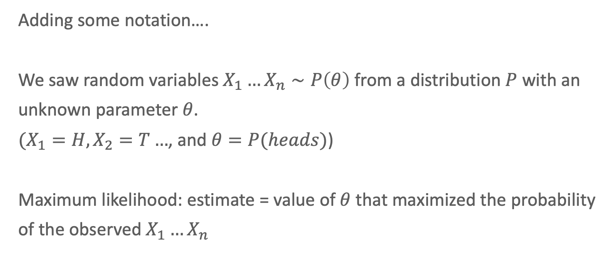
Estimation
Adding some notation….
We saw random variables $X_{1}…X_{n}∼P\left(θ\right)$ from a distribution $P$ with an unknown parameter $θ$.
$(X_{1}=H, X_{2}=T…$, and $θ=P(heads)$)
Maximum likelihood: estimate = value of $θ$ that maximized the probability of the observed $X_{1}…X_{n}$

Slide 8
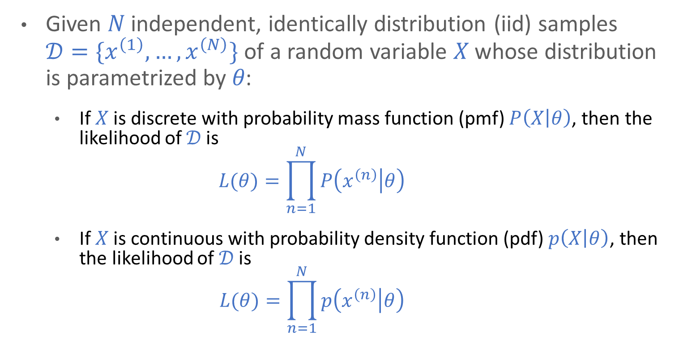
Likelihood
Given 𝑁 independent, identically distribution (iid) samples $𝒟=\{x^{\left(1\right)}, …, x^{\left(N\right)}\}$ of a random variable 𝑋 whose distribution is parametrized by 𝜃:
If 𝑋 is discrete with probability mass function (pmf) $P\left(X | θ\right)$, then the likelihood of 𝒟 is
$$L(θ)=\prod_{n=1}^{N}{P\left(x^{\left(n\right)} | θ\right)}$$
If 𝑋 is continuous with probability density function (pdf) $p\left(X | θ\right)$, then the likelihood of 𝒟 is
$$L(θ)=\prod_{n=1}^{N}{p\left(x^{\left(n\right)} | θ\right)}$$

Slide 9
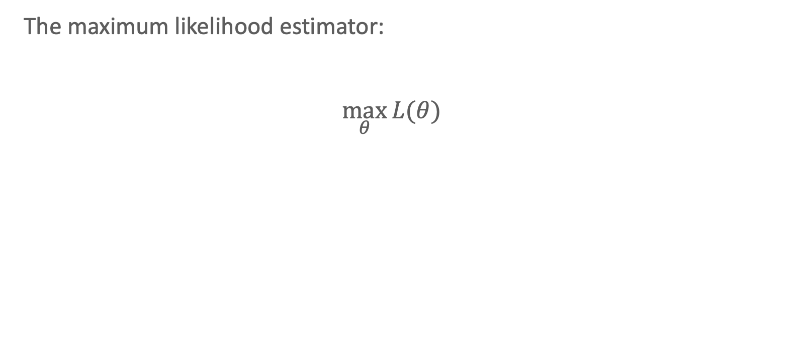
Estimation
The maximum likelihood estimator:
$$\max_{θ}{L(θ)}$$

Slide 10
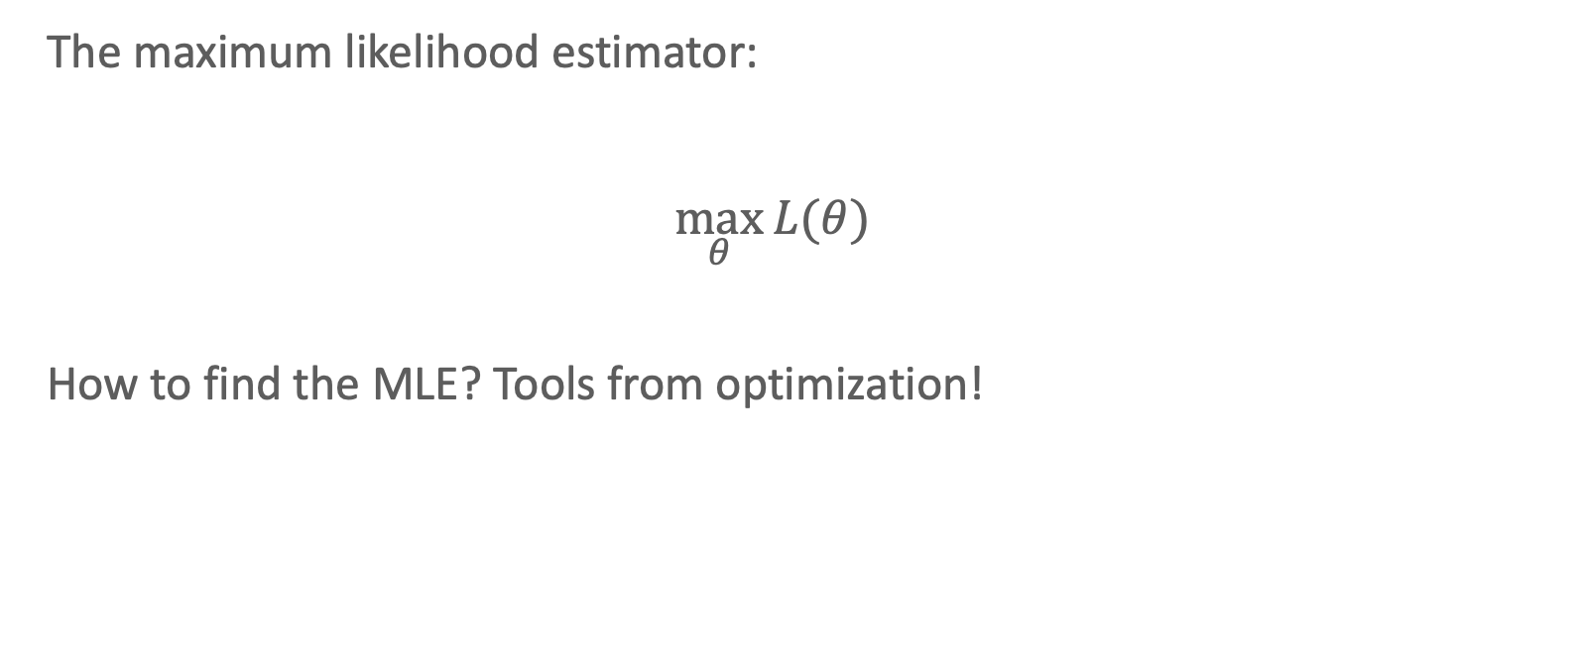
Estimation
The maximum likelihood estimator:
$$\max_{θ}{L(θ)}$$
How to find the MLE? Tools from optimization!

Slide 11
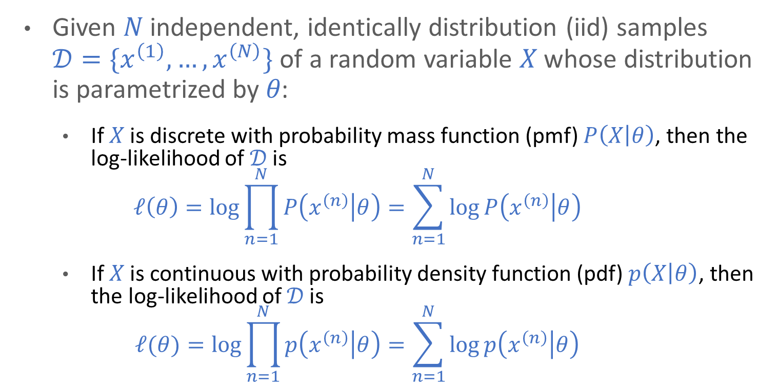
Log-Likelihood
Given 𝑁 independent, identically distribution (iid) samples $𝒟=\{x^{\left(1\right)}, …, x^{\left(N\right)}\}$ of a random variable 𝑋 whose distribution is parametrized by 𝜃:
If 𝑋 is discrete with probability mass function (pmf) $P\left(X | θ\right)$, then the log-likelihood of 𝒟 is
$$ℓ\left(θ\right)=\log{\prod_{n=1}^{N}{P\left(x^{\left(n\right)} | θ\right)}}=\sum_{n=1}^{N}{\log{P\left(x^{\left(n\right)} | θ\right)}}$$
If 𝑋 is continuous with probability density function (pdf) $p\left(X | θ\right)$, then the log-likelihood of 𝒟 is
$$ℓ(θ)=\log{\prod_{n=1}^{N}{p\left(x^{\left(n\right)} | θ\right)}}=\sum_{n=1}^{N}{\log{p\left(x^{\left(n\right)} | θ\right)}}$$

Slide 12
Whiteboard
Write the likelihood for a Binomial variable
Take the log
Take the derivative and set it equal to 0

Slide 13
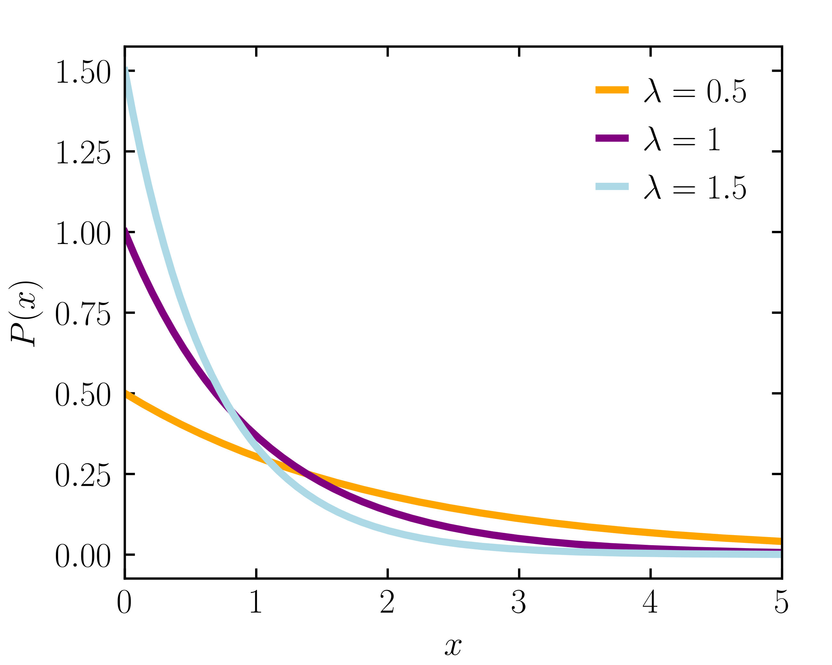
Maximum Likelihood Estimation (MLE)
A second example: wait times
Suppose you observe samples of wait times in line at your favorite ice cream place.
How long should you expect to wait in the future? What is the probability you’ll wait at least 5 min?
Example: the exponential distribution
$$\left\{x^{\left(1\right)}=0.5, x^{\left(2\right)}=1\right\}$$

Slide 14
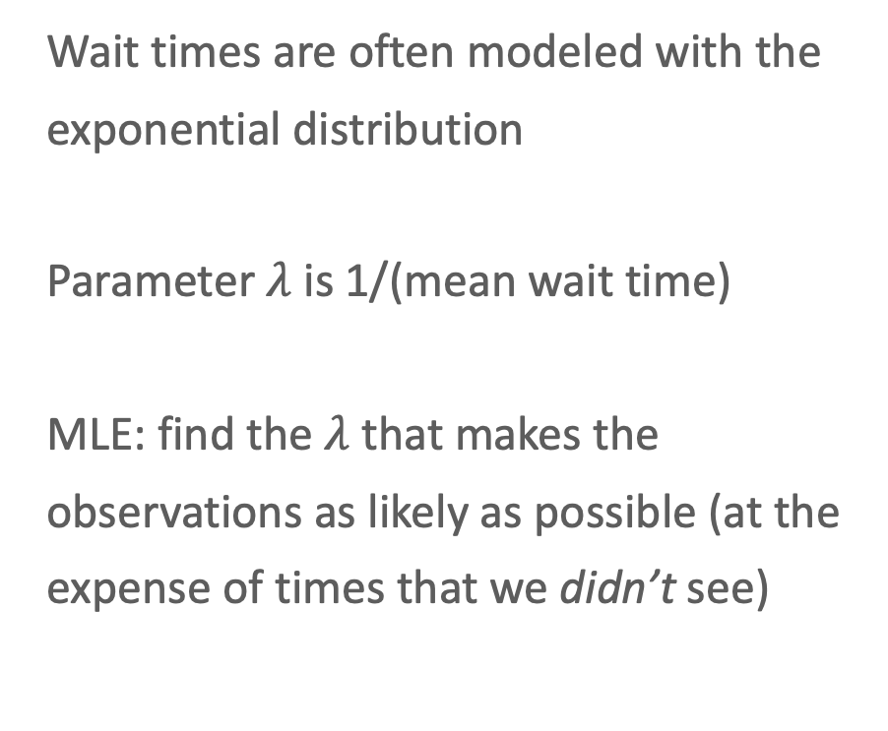
Maximum Likelihood Estimation (MLE)
Wait times are often modeled with the exponential distribution
Parameter $λ$ is 1/(mean wait time)
MLE: find the $λ$ that makes the observations as likely as possible (at the expense of times that we didn’t see)
Example: the exponential distribution
$$\left\{x^{\left(1\right)}=0.5, x^{\left(2\right)}=1\right\}$$

Slide 15
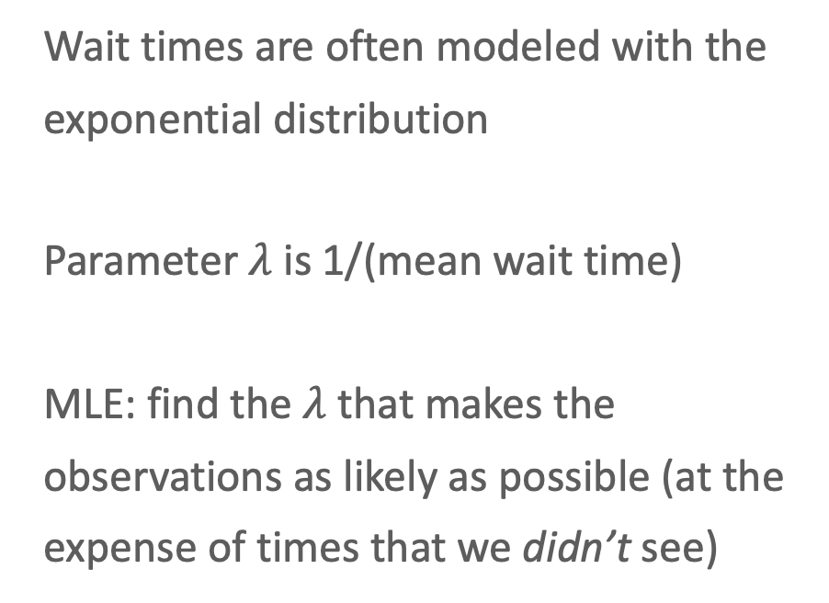
Maximum Likelihood Estimation (MLE)
Wait times are often modeled with the exponential distribution
Parameter $λ$ is 1/(mean wait time)
MLE: find the $λ$ that makes the observations as likely as possible (at the expense of times that we didn’t see)
Example: the exponential distribution
$$\left\{x^{\left(1\right)}=2, x^{\left(2\right)}=3\right\}$$

Slide 16
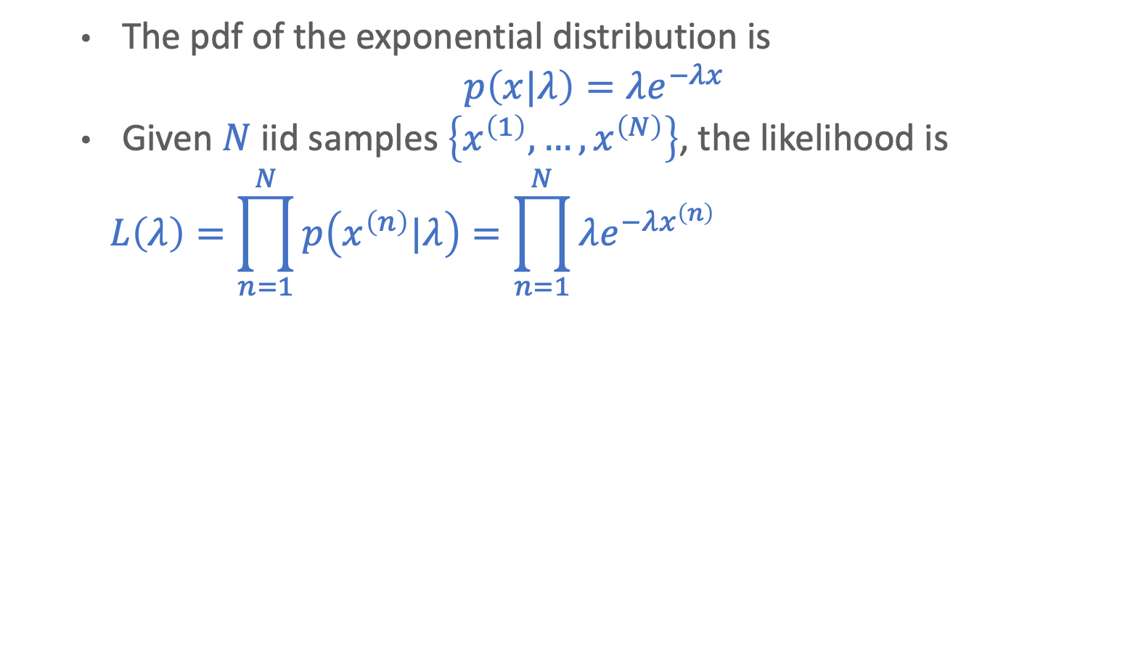
Exponential Distribution MLE
The pdf of the exponential distribution is
$$p\left(x|λ\right)=λe^{−λx}$$
Given $N$ iid samples $\left\{x^{\left(1\right)}, …, x^{\left(N\right)}\right\}$, the likelihood is
$$L\left(λ\right)=\prod_{n=1}^{N}{p\left(x^{\left(n\right)}|λ\right)}=\prod_{n=1}^{N}{λe^{−λx^{\left(n\right)}}} =\sum_{n=1}^{N}{\log{λ}+}\log{e^{−λx^{\left(n\right)}}}$$

Slide 17
Whiteboard
Converting to log-likelihood and finding the MLE

Slide 18
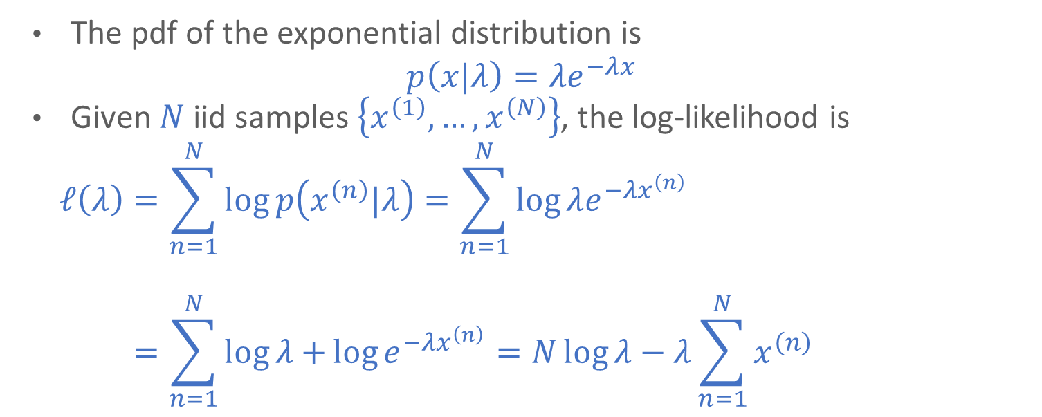
Exponential Distribution MLE
The pdf of the exponential distribution is
$$p\left(x|λ\right)=λe^{−λx}$$
Given $N$ iid samples $\left\{x^{\left(1\right)}, …, x^{\left(N\right)}\right\}$, the log-likelihood is
$$ℓ\left(λ\right)=\sum_{n=1}^{N}{\log{p\left(x^{\left(n\right)}|λ\right)}}=\sum_{n=1}^{N}{\log{λe^{−λx^{\left(n\right)}}}}$$
$$ℓ\left(λ\right)=\sum_{n=1}^{N}{\log{λ}+}\log{e^{−λx^{\left(n\right)}}}=N\log{λ}−λ\sum_{n=1}^{N}{x^{\left(n\right)}}$$

Slide 19
Exponential Distribution MLE
The pdf of the exponential distribution is
$$p\left(x|λ\right)=λe^{−λx}$$
We can solve for the optimal value of $λ$ by taking the partial derivative of the log-likelihood and setting it equal to $0$:
$$ℓ\left(λ\right)=N\log{λ}−λ\sum_{n=1}^{N}{x^{\left(n\right)}}$$
$$\frac{∂ℓ}{∂λ}=\frac{N}{λ}−\sum_{n=1}^{N}{x^{\left(n\right)}} \\ →\frac{N}{\hat{λ}}−\sum_{n=1}^{N}{x^{\left(n\right)}}=0→\frac{N}{\hat{λ}}=\sum_{n=1}^{N}{x^{\left(n\right)}}→\hat{λ}=\frac{N}{\sum_{n=1}^{N}{x^{\left(n\right)}}}$$

Slide 20
Exponential Distribution MLE
The pdf of the exponential distribution is
$$p\left(x|λ\right)=λe^{−λx}$$
We can solve for the optimal value of $λ$ by taking the partial derivative of the log-likelihood and setting it equal to $0$:
$$ℓ\left(λ\right)=N\log{λ}−λ\sum_{n=1}^{N}{x^{\left(n\right)}}$$
$$\frac{∂ℓ}{∂λ}=\frac{N}{λ}−\sum_{n=1}^{N}{x^{\left(n\right)}} \\ →\frac{N}{\hat{λ}}−\sum_{n=1}^{N}{x^{\left(n\right)}}=0→\frac{N}{\hat{λ}}=\sum_{n=1}^{N}{x^{\left(n\right)}}→\hat{λ}=\frac{N}{\sum_{n=1}^{N}{x^{\left(n\right)}}}$$

Slide 21
Another example
MLE of the univariate Gaussian distribution

Slide 22
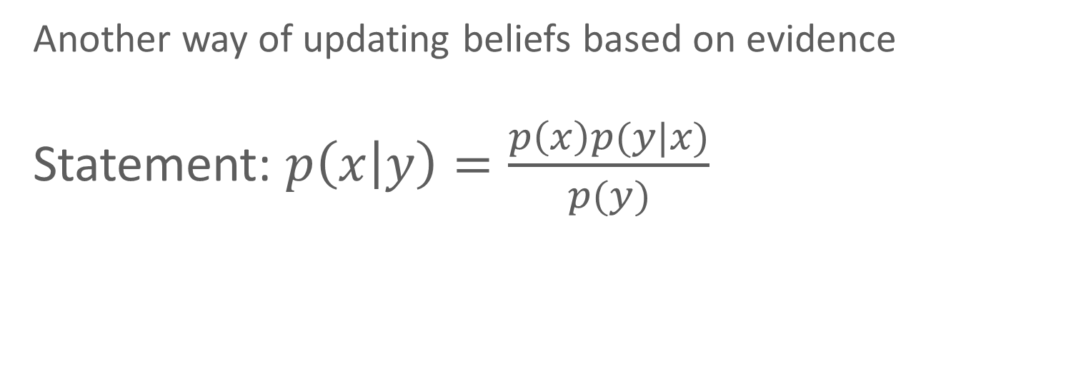
Bayes theorem
Another way of updating beliefs based on evidence
Statement: $p\left(x | y\right)=\frac{p\left(x\right)p(y|x)}{p(y)}$

Slide 23
Bayes theorem
Suppose that a bag has two coins: one fair and one unfair. For the unfair coin, p(heads) = 0.7
I take a coin out of the bag and start flipping it. Based on the results, I want to determine whether it is fair or unfair

Slide 24
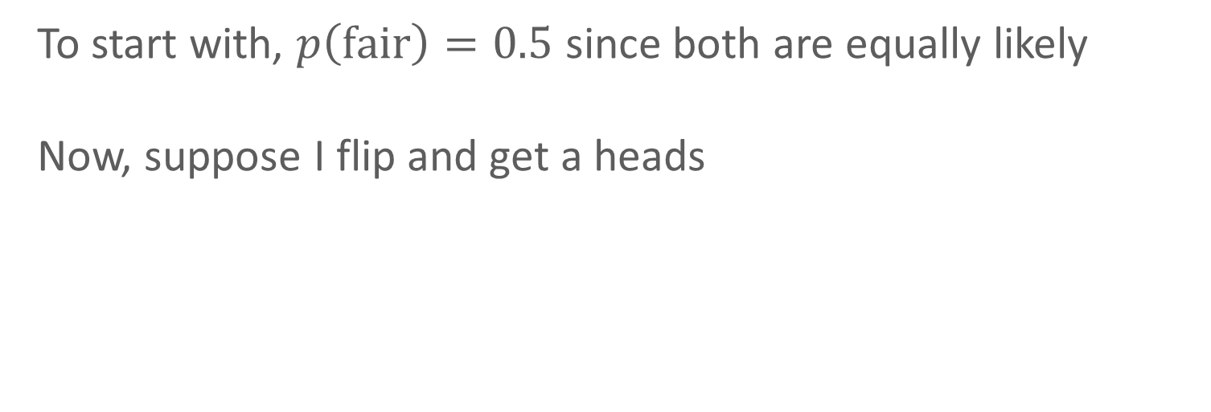
Bayes theorem
To start with, $p\left(fair\right)=0.5$ since both are equally likely
Now, suppose I flip and get a heads

Slide 25
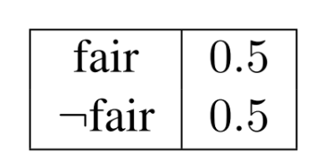
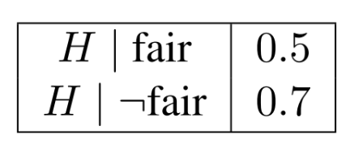
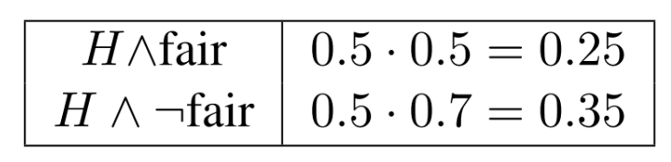

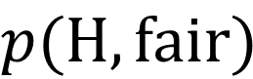
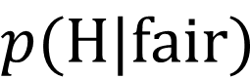
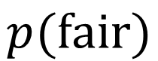

Bayes theorem
$$p(fair)$$
$$p(H|fair)$$
$$p(H,fair)$$
$$×$$
$$=$$

Slide 26
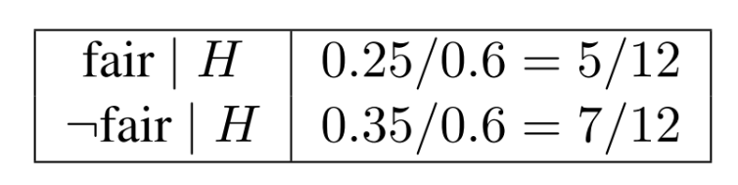

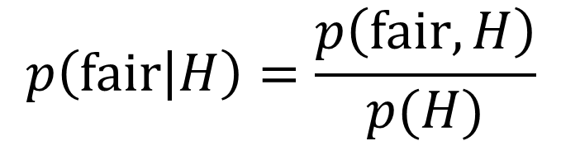
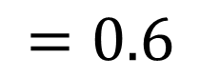
Bayes theorem
$$p(fair)$$
$$p(H|fair)$$
$$p(H,fair)$$
$$×$$
$$=$$
$$=0.6$$
$$p\left(fair | H\right)=\frac{p\left(fair, H\right)}{p(H)}$$
$$=$$

Slide 27
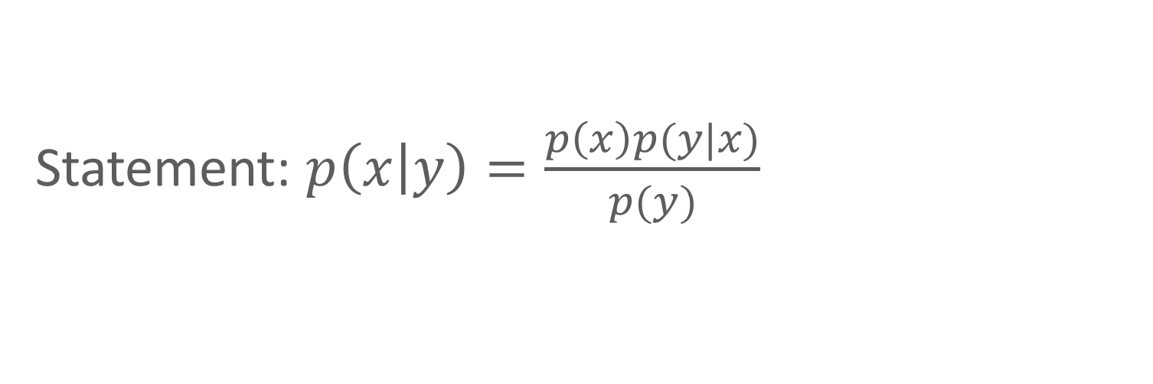
Bayes theorem
Prior
Likelihood
Statement: $p\left(x | y\right)=\frac{p\left(x\right)p(y|x)}{p(y)}$
Posterior
Evidence

Slide 28
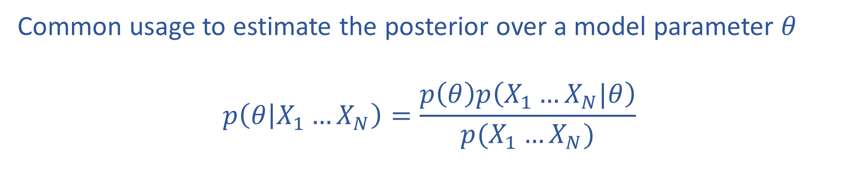
Bayes rule
Common usage to estimate the posterior over a model parameter $θ$
$$p\left(θ | X_{1}…X_{N}\right)=\frac{p\left(θ\right)p\left(X_{1}…X_{N}|θ\right)}{p(X_{1}…X_{N})}$$

Slide 29
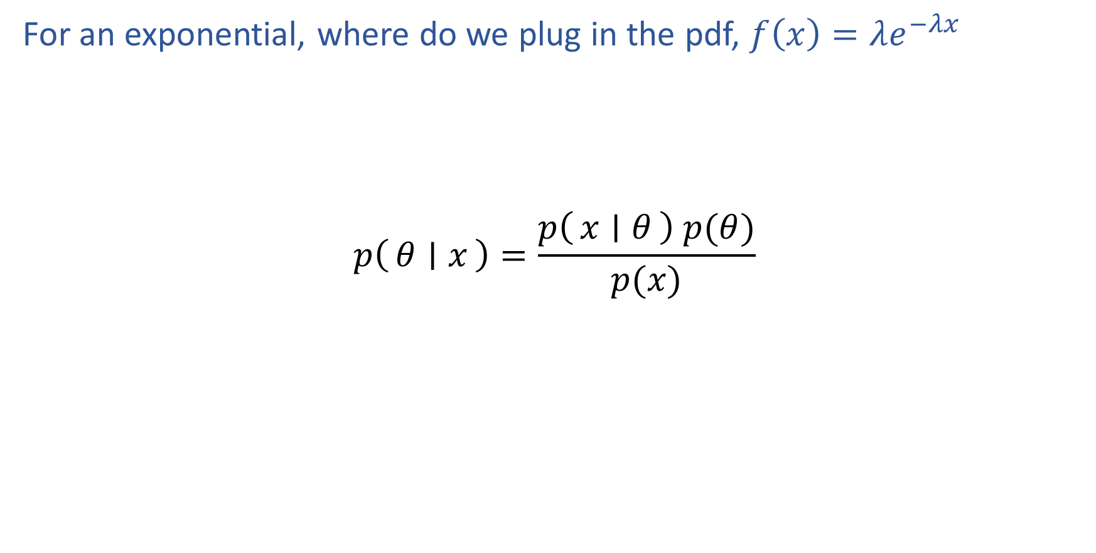
Poll 3
For an exponential, where do we plug in the pdf, $f\left(x\right)=λe^{−λx}$
$$p\left(θ ∣ x\right)=\frac{p\left(x ∣ θ\right) p(θ)}{p(x)}$$
B
C
A
D

Slide 30
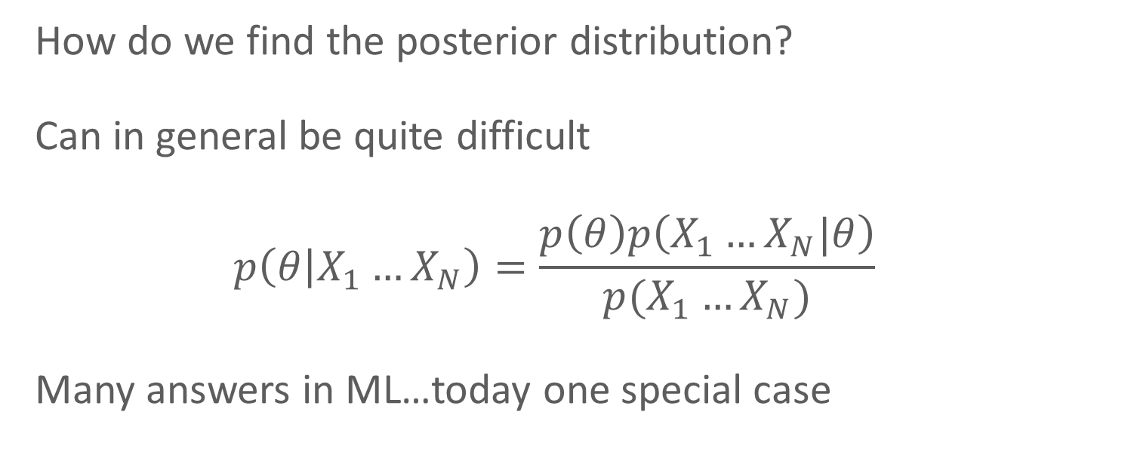
Bayesian inference
How do we find the posterior distribution?
Can in general be quite difficult
$$p\left(θ | X_{1}…X_{N}\right)=\frac{p\left(θ\right)p\left(X_{1}…X_{N}|θ\right)}{p(X_{1}…X_{N})}$$
Many answers in ML…today one special case

Slide 31
Conjugate priors
Key question: form of the prior and likelihood
For some (prior, likelihood) pairs, the posterior is in the same family as the prior (“conjugate prior”)

Slide 32
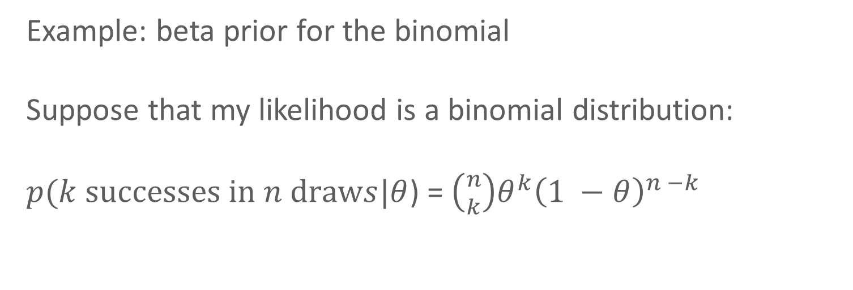
Conjugate priors
Example: beta prior for the binomial
Suppose that my likelihood is a binomial distribution:
$p(k successes in n draws|θ$) = $\left({n \atop k}\right)θ^{k}{\left(1 −θ\right)}^{n −k}$

Slide 33
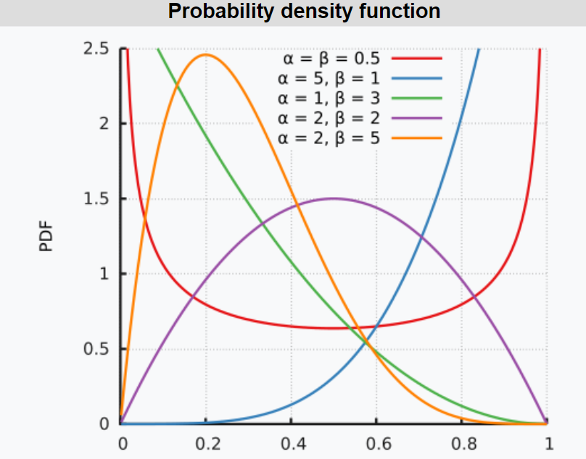
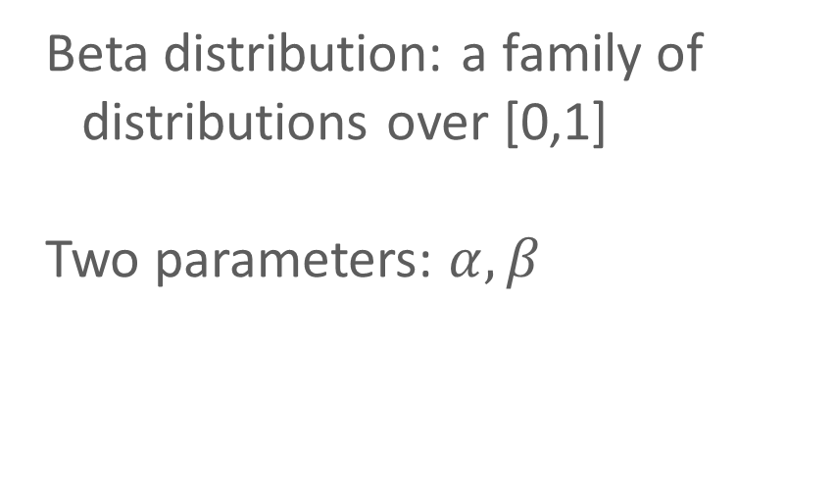
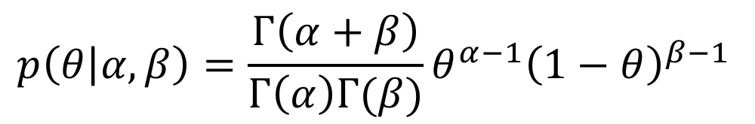
Conjugate priors
Beta distribution: a family of distributions over [0,1]
Two parameters: $α, β$
$$p\left(θ | α, β\right)=\frac{Γ\left(α+β\right)}{Γ\left(α\right)Γ(β)}θ^{α−1}{\left(1−θ\right)}^{β−1 }$$

Slide 34
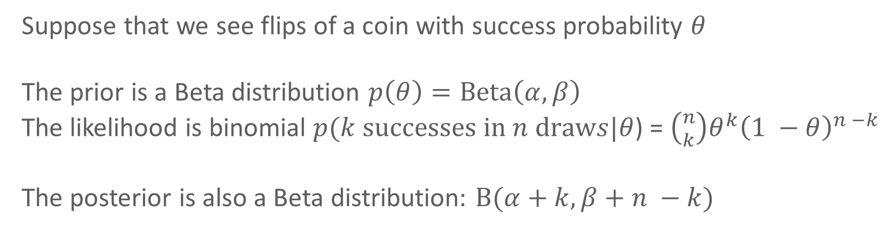
Conjugate priors
Suppose that we see flips of a coin with success probability $θ$
The prior is a Beta distribution $p\left(θ\right)=Beta\left(α, β\right)$
The likelihood is binomial $p(k successes in n draws|θ$) = $\left({n \atop k}\right)θ^{k}{\left(1 −θ\right)}^{n −k}$
The posterior is also a Beta distribution: $Β(α+k, β+n −k)$

Slide 35
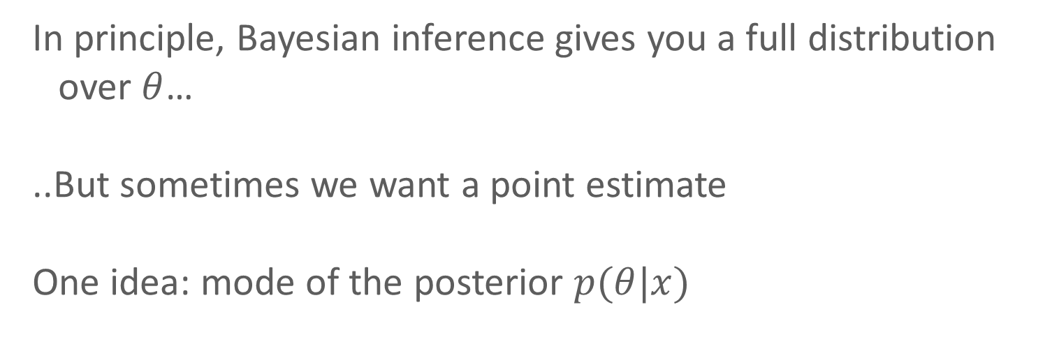
Maximum a posteriori (MAP) inference
In principle, Bayesian inference gives you a full distribution over $θ$…
..But sometimes we want a point estimate
One idea: mode of the posterior $p(θ|x)$

Slide 36
MLE vs. MAP
Maximum Likelihood Estimate (MLE)
Maximum a posteriori (MAP) estimate
Prior
Slide credit: CMU MLD Matt Gormley

Slide 37
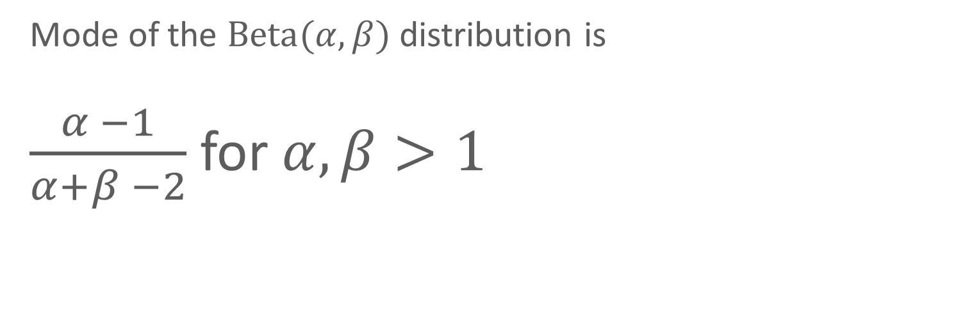
MAP for the Beta-binomial model
Mode of the $Beta(α, β)$ distribution is
$\frac{α −1}{α+β −2}$ for $α, β>1$

Slide 38
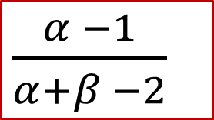
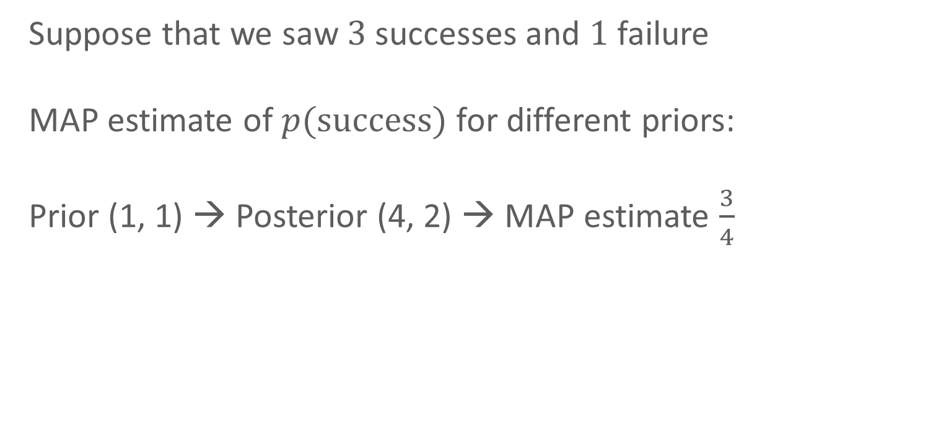
MAP for the Beta-binomial model
Suppose that we saw $3$ successes and $1$ failure
MAP estimate of $p(success)$ for different priors:
Prior (1, 1) → Posterior (4, 2) → MAP estimate $\frac{3}{4}$
$\frac{α −1}{α+β −2}$

Slide 39
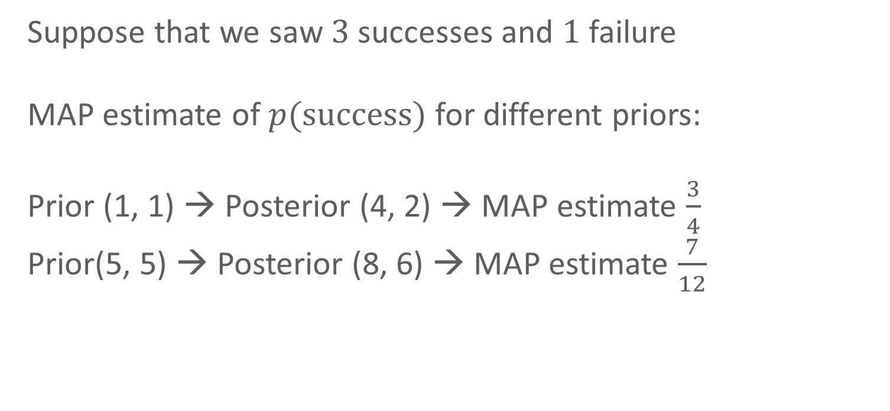
MAP for the Beta-binomial model
Suppose that we saw $3$ successes and $1$ failure
MAP estimate of $p(success)$ for different priors:
Prior (1, 1) → Posterior (4, 2) → MAP estimate $\frac{3}{4}$
Prior(5, 5) → Posterior (8, 6) → MAP estimate $\frac{7}{12}$
$\frac{α −1}{α+β −2}$

Slide 40
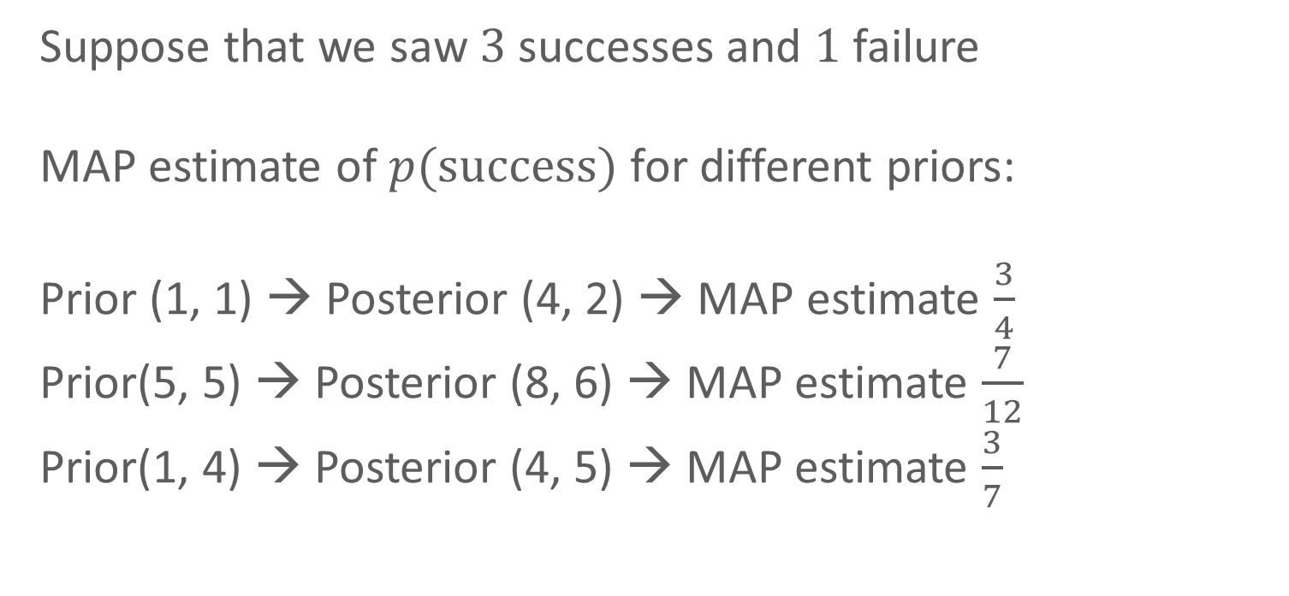
MAP for the Beta-binomial model
Suppose that we saw $3$ successes and $1$ failure
MAP estimate of $p(success)$ for different priors:
Prior (1, 1) → Posterior (4, 2) → MAP estimate $\frac{3}{4}$
Prior(5, 5) → Posterior (8, 6) → MAP estimate $\frac{7}{12}$
Prior(1, 4) → Posterior (4, 5) → MAP estimate $\frac{3}{7}$
$\frac{α −1}{α+β −2}$

